Slide 1

Title: Data Preprocessing & Visualization Subtitle: Student Performance Analyser
Team name : SiGmA_X
Team members name : 1. Akshat Raj
2.Chaman kumar
3. Shivam pandey
4. Twinkle
🎯 Objective: Clean, transform, and visualize the dataset to find insights
🛠 Tools: Python, Pandas, Seaborn, Matplotlib, NumPy
📂 Dataset Info: 1000+ rows, features like gender, scores, parental education
🧰 GitHub link (with QR code or short URL)

Slide 2
Introduction / Problem Statement
🎯 Goal: Clean, transform, and visualize the dataset to uncover meaningful insights related to student performance.
📘 Problem Statement: Students’ academic performance is influenced by multiple factors such as study time, parental education, and test preparation. The aim is to explore how these factors affect performance through data analysis and visualization.
🧰 Tools & Libraries Used:
Python – Primary programming language
Pandas – Data manipulation and transformation
NumPy – Numerical computations
Matplotlib – Basic data visualization
Seaborn – Statistical data visualization

Slide 3
Data set overview
📁 Dataset Used: Student Performance Dataset
📌 Source: Available on [Kaggle] :https://www.kaggle.com/datasets/spscientist/students-performance-in-exams/data
📊 Dataset Size:
Total Rows: 1000 (or 11 for demo purposes)
Total Columns: 8
🔍 Column Breakdown:
Categorical (5): Gender, Parental Education Level, Lunch Type, Test Preparation Course, etc.
Numerical (3): Math Score, Reading Score, Writing Score
🎯 Analysis Goal: Understand how various background factors like gender, parental education, and test preparation affect students' academic performance.

Slide 4
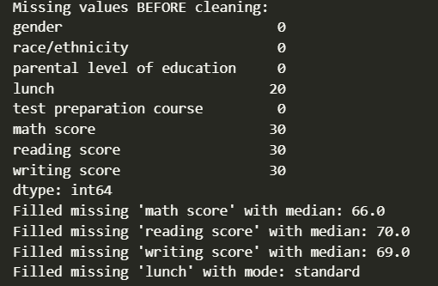
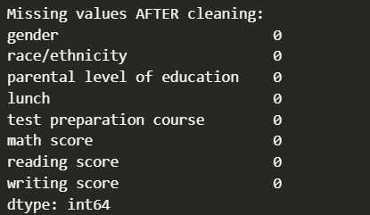
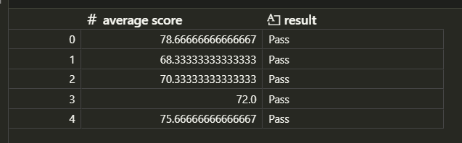

Data Integrity, Summary & Transformation
🔍 Cleaning & Missing Values (5 marks)
Checked null values using df.isnull().sum()
No missing values / handled with imputation (if any)
Removed outliers in math score using IQR method
🧱 Feature Engineering (5 marks)
Created average score from three subject scores
Created log avg score for normalization
Converted categorical variables for analysis if needed

Slide 5
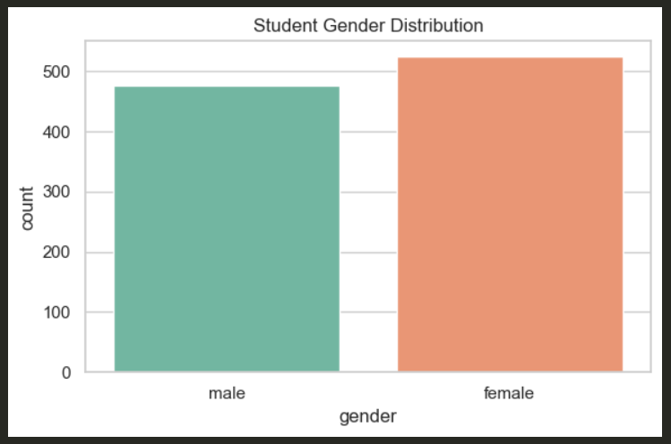
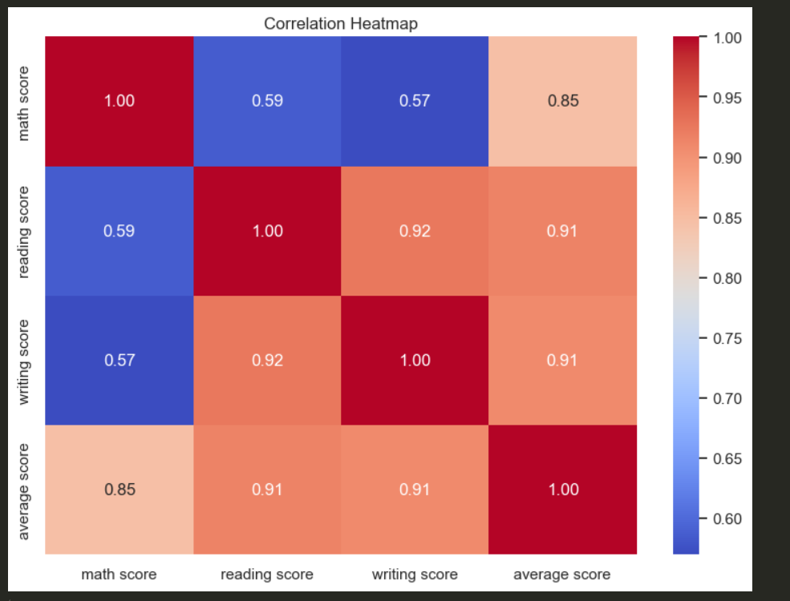
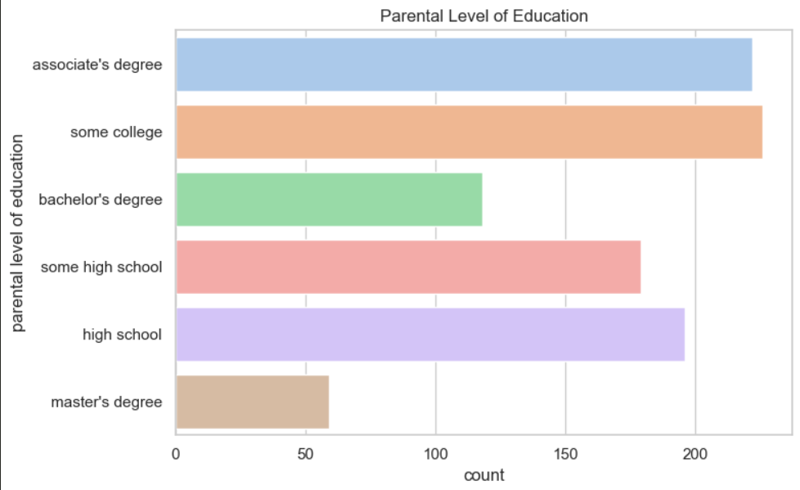
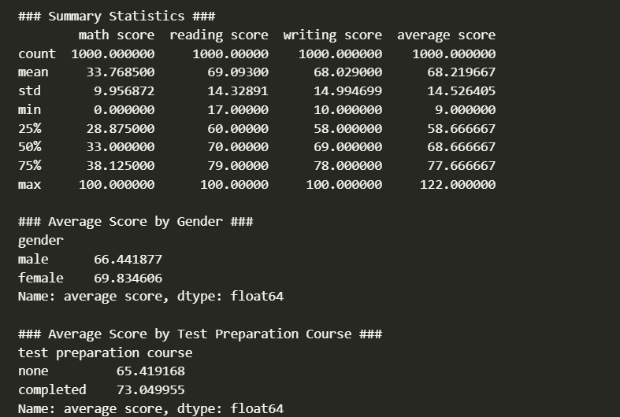
🔒 Data Integrity
Verified column data types, unique values
Ensured no duplicates and consistent formats
📊 Summary Statistics
Used describe() and groupby()
Found test prep improves average scores
⚙️ Transformations
Applied log transformation on average score
Result: Reduced skewness, normalized data distribution

Slide 6
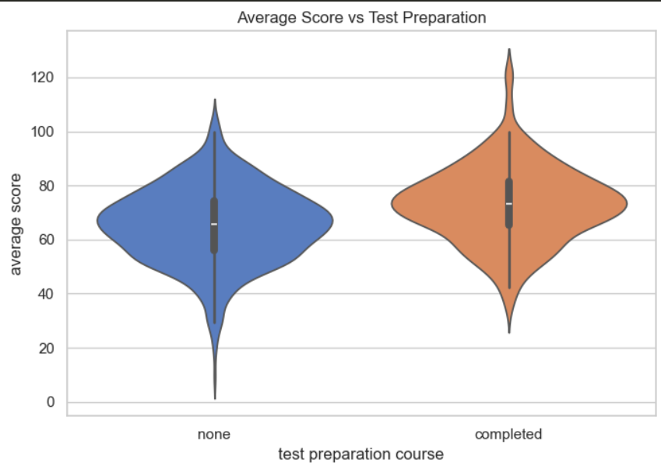
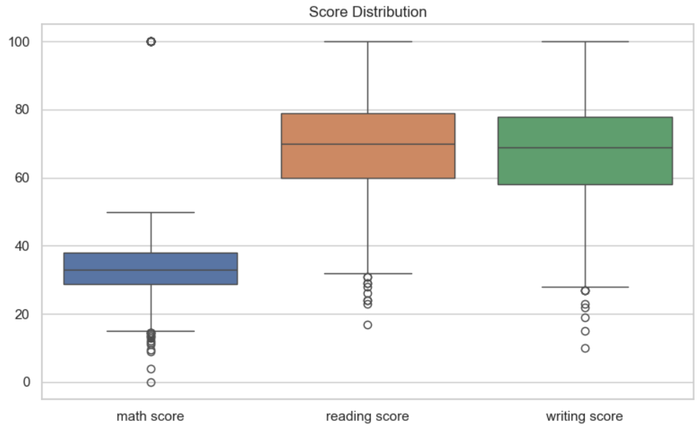
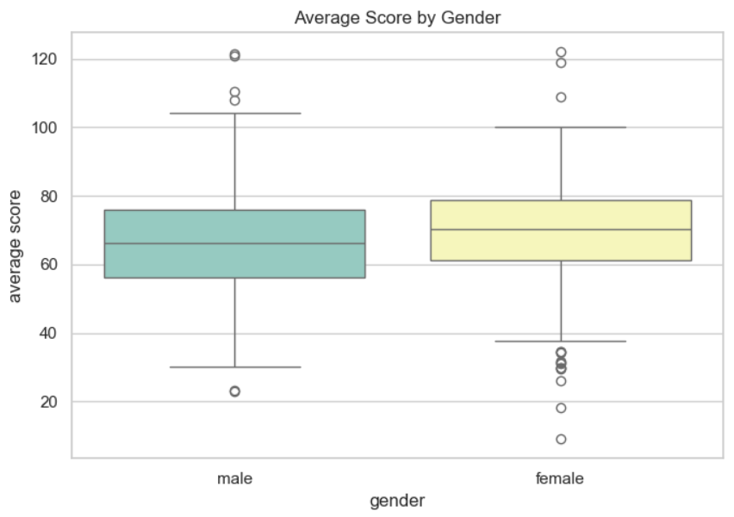
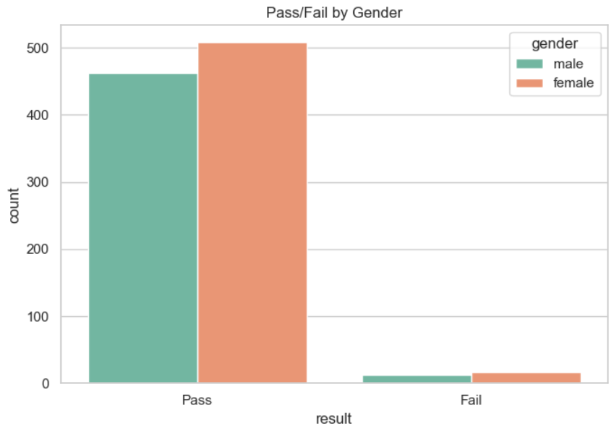
Patterns, Trends, & Anomalies
📈 Visualizations
Heatmap: Correlation between numerical scores
Violin Plot: Higher avg score for test-prepared students
Boxplot: Score variation across gender
Countplot: Gender distribution in Pass/Fail
Score Boxplot: Distribution across subjects 🧠 Insights:
Gender & test prep affect performance
Few outliers in subject scores

Slide 7
Conclusion & GitHub
Key Takeaways:
Clean dataset, engineered features, normalized scores
Strong correlation between reading & writing
Test preparation boosts performance
📎 GitHub Link: github.com/your_repo_here 📁 Includes: README, notebook, dataset, and visuals

